Slide 1









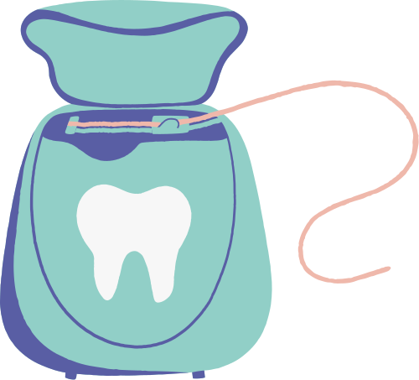
NEW SMILE Dental Clinic
NEW SMILE
DENTAL CLINIC APP
Team Members
Anisa Marshanda Soeun-202400156
Saw Eh Thalay Htoo-202300150
Khin Thitsar Thant - 202300141
Course - IT 124 Human-Computer Interaction
Lecturer Name - Dr. Gakwaya Nkundimana Joel
Submission Date - 05-May-2025

Slide 2

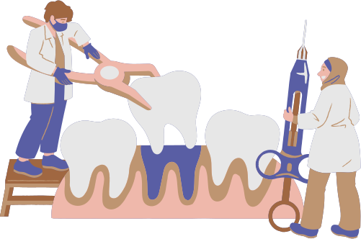
PROBLEM & OBJECTIVES
🎯 Objective
Our goal is to design a smart and user-friendly dental clinic app that helps users:
Book appointments quickly
View dentist profiles and services
Manage their dental visits with ease
🦷 Problem
Booking dental appointments can be confusing, slow, and inconvenient. Many users don’t know which dentist to choose what services are offered, or how to manage their visits easily especially for first-time or busy patients.

Slide 3
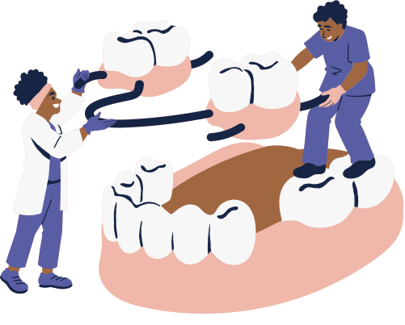

INNOVATIVE CONCEPT
💡 What Makes Our App Innovative?
A clean and simple design that’s easy for all users, including the elderly and first-time patients.
Quick booking flow that lets users select a dentist, choose a time, and confirm with just a few taps.
Dentist profile pages that show clear information about qualifications and services.
Navigation bar for smooth access to booking, profile, and home screens.
Designed using Human-Computer Interaction (HCI) principles to improve user satisfaction and reduce confusion.

Slide 4
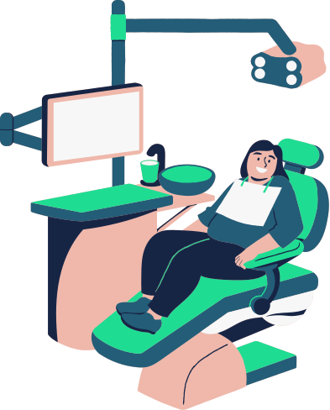
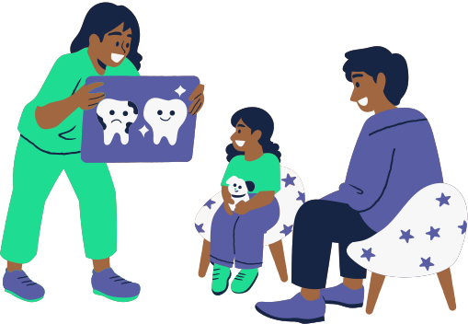
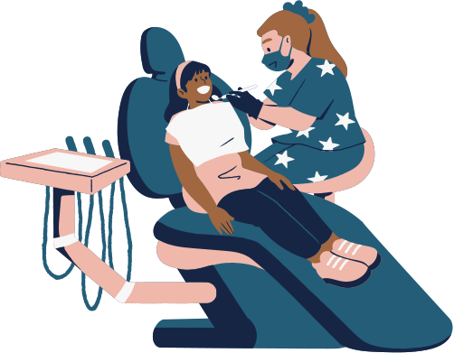
TARGET USERS & USER RESEARCH
🎯 Who Will Use This App?
Students – who want fast and easy appointment booking between classes.
Working adults – who have busy schedules and prefer quick, mobile access to services.
Elderly users – who need a simple, clear interface to avoid confusion.
👥 Why These Users?
Many people find calling or visiting clinics inconvenient.
Users want to view available dentists, services, and book appointments in just a few steps.
Our app is designed to meet their needs with clarity, comfort, and speed.

Slide 5
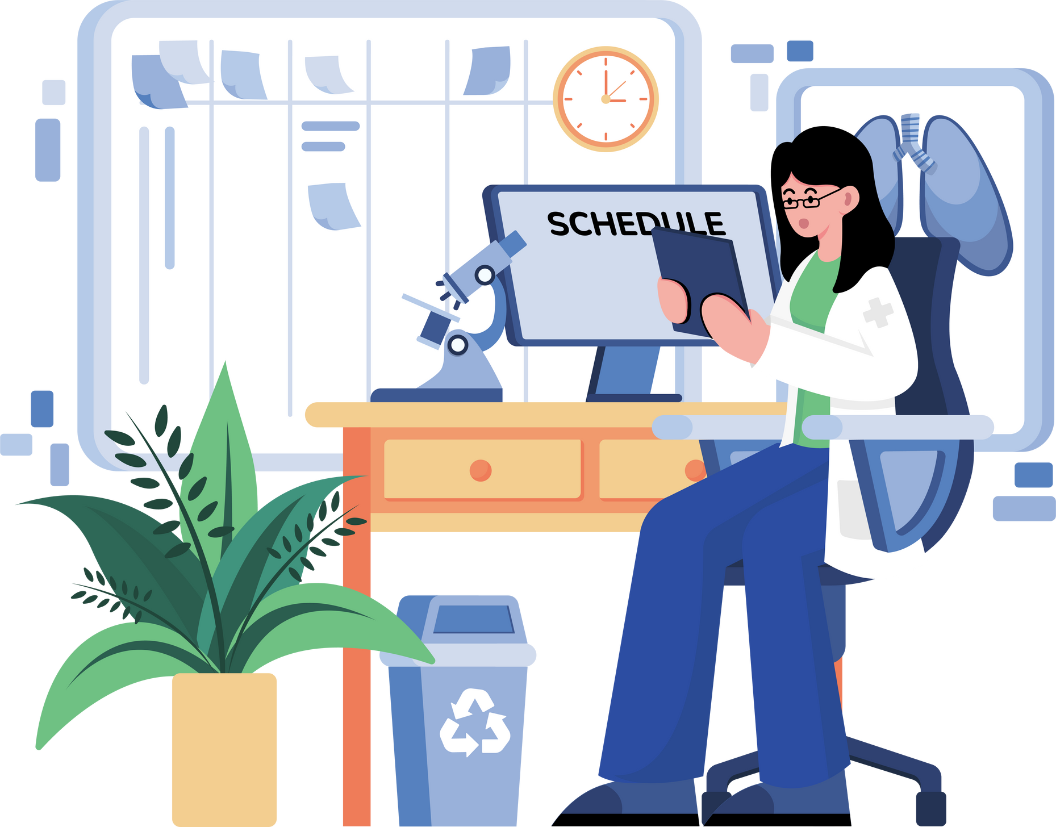

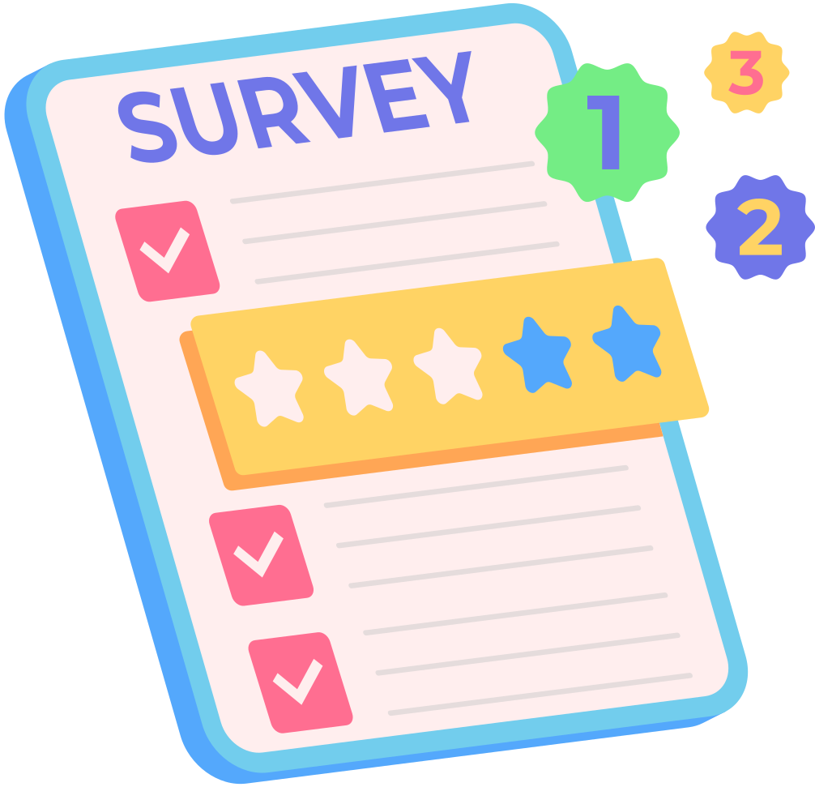
USER RESEARCH
📝 How We Collected Feedback
We conducted a simple survey with students and adults.
Asked about how they currently book dental appointments and what problems they face.
🔍 Key Findings
Most users want a faster and easier way to book appointments.
Some users forget appointments or are unsure which dentist to choose.
Users prefer a mobile app with clear options and simple navigation.
👤 How It Helped Us
Guided the design of the home screen, booking system, and dentist profiles.
Helped us focus on clarity, speed, and accessibility in our app.

Slide 6

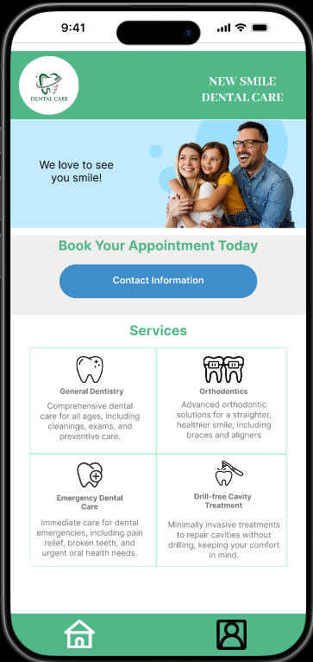
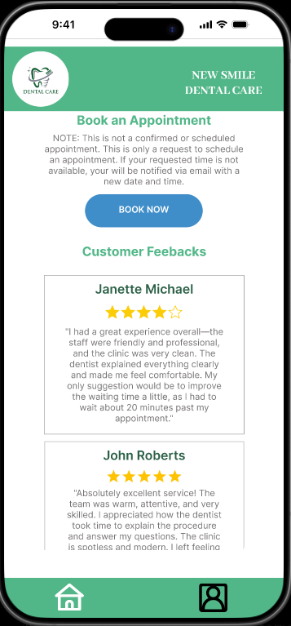
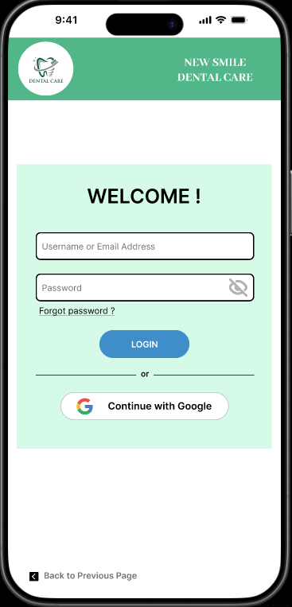
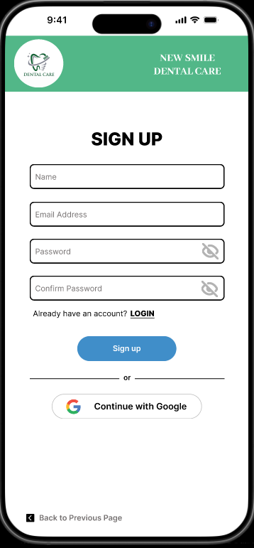
🏠 Home Screen
Friendly welcome message and image
“Book Now” and “Contact Info” buttons
Icons to explain available services
Easy access navigation bar (Home & Profile)
Home page are scrollable, we set it to scroll with parent vertically.
DESIGN PROCESS
🔐 Login / Sign Up Screen
Simple form for new users to create an account
Fields for name, email, password
Clear button for login in or signing up for new account
Designed to be fast and user-friendly for all age groups

Slide 7
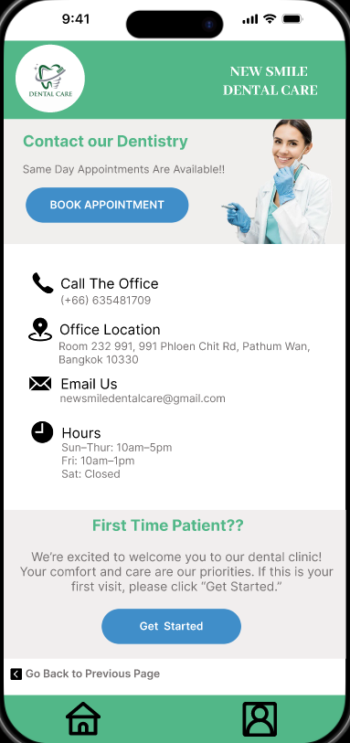
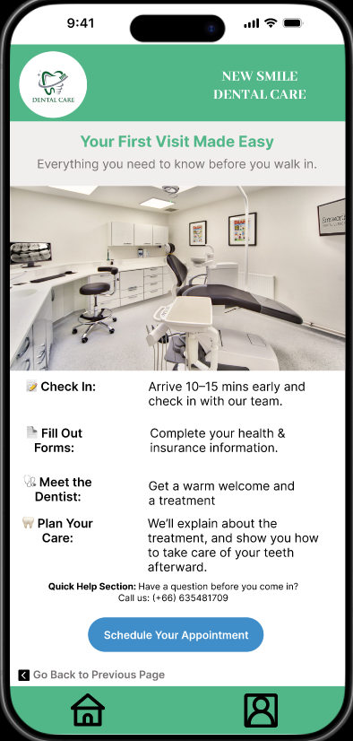

📞 Contact Us Screen
Displays clinic contact details in a clean, minimal layout
Includes a “Get Started” button for new patients
When clicked, it takes the user to the First-Time Patient page
DESIGN PROCESS
🆕 First-Time Patient Page
Provides a step-by-step overview of what to expect before a visit:
Check-in process
Filling out medical forms
Meeting the dentist
Includes a “Schedule Your Appointment” button
Clicking this button takes the user to the Dentist Page to begin booking
Designed to make first-time visitors feel confident and prepared

Slide 8
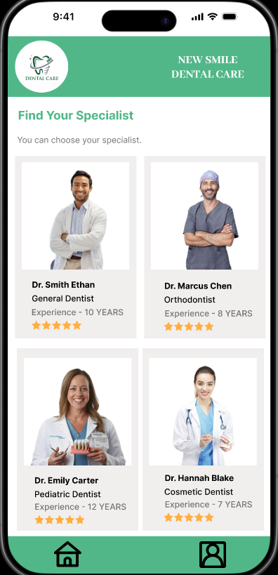
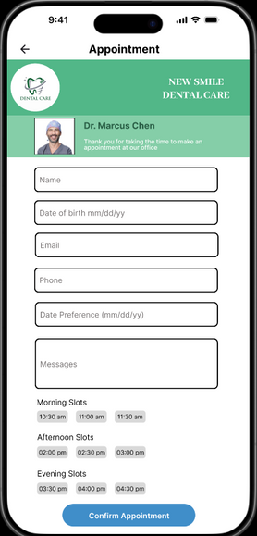
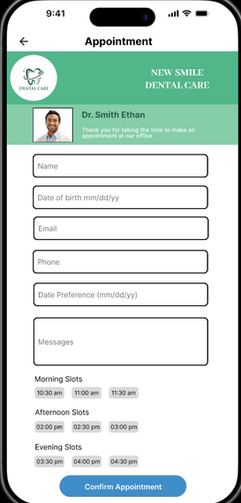
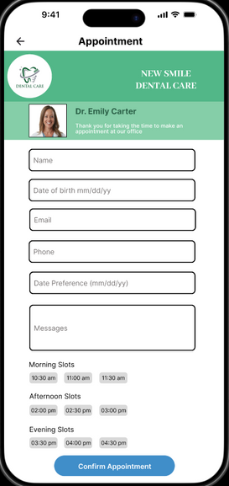
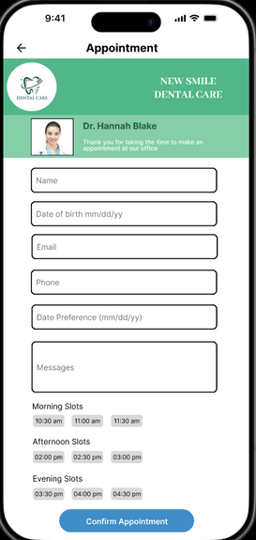
DESIGN PROCESS
📅 Booking Appointment Page
Users fill in the appointment form with the
following details:
👤 Full Name
🎂 Date of Birth
📧 Email
📞 Phone Number
📅 Date Preference
⏰ Time Selection
✍️ Message (optional)
After completing the form, users click the “Confirm Appointment” button at the bottom
🔍 Find Specialist Page
Shows a scrollable list of dentists with:
📸 Profile photo
👨‍⚕️ Full name
🏅 Position (e.g., Orthodontist, General Dentist)
📆 Years of experience
Users can click on the dentist card or photo they want
This action leads directly to the Appointment Form Page, making the booking process quick and simple

Slide 9
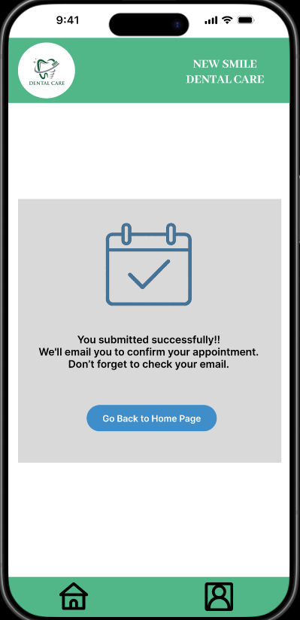
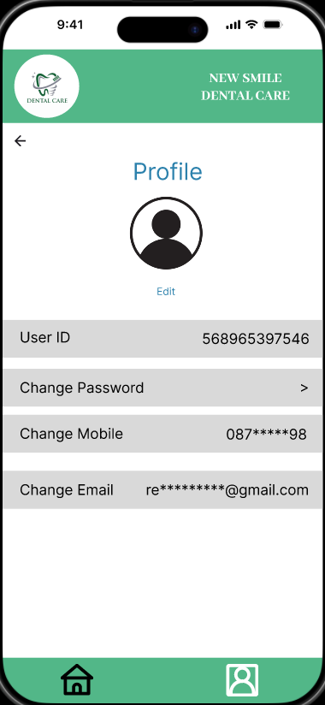

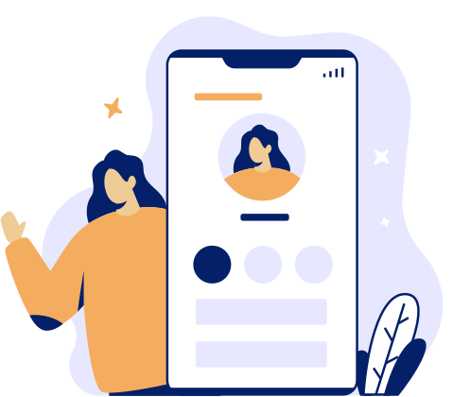
DESIGN PROCESS
👤 Profile Page
Shows:
User ID
Profile photo (with option to edit)
Current email, mobile number, and password
Users can:
Change email
Change mobile number
Change password
Designed to let users easily manage and update their personal information
✅ Confirm Appointment Page
Displays a success message:
"You have submitted your appointment request successfully."
"We will send you an email to confirm the appointment."
"Please don't forget to check your email."
Includes a “Go Back to Home Page” button
Clicking it takes the user back to the Home screen for further browsing or booking

Slide 10


FIGMA PROTOTYPE
🖼️ High-Fidelity Design in Figma
All screens were created using Figma based on user feedback and HCI principles
Features a clean layout, easy navigation, and a mobile-friendly interface
Includes all core pages: Home, Login/Sign up, Contact Us, Find Specialist, Booking, Confirmation, and Profile
🔗 View Our Prototype:
https://www.figma.com/design/IDuBmt7p53k869imwrEGgr/HCI-Project?node-id=137-878&t=5N3sHcNnM6HGVezx-1

Slide 11

USABILITY TESTING
Tested with 3 users
Positive feedback on layout and navigation
Improvement made: clearer button labels and simplified booking form
User 1
Liked the clean layout and easy navigation
Found some button labels unclear
Suggested improving button text for better understanding
Improvement made: Clearer button labels added
User 2
Tested the flow from “Contact Us” to “First Time Patient”
Appreciated the helpful information for new patients
Felt the booking form was too long with unnecessary fields
Improvement made: Simplified the booking form
User 3
Completed all tasks without confusion
Praised the modern and professional design
Suggested increasing text size for better readability
Improvement made: Increased font size in key areas

Slide 12
HCI PRINCIPLE
🪧 Visibility
Clear labels and icons guide users at every step
Users can easily see what actions are available
✅ Feedback
After booking an appointment, a confirmation page shows the request was successful
Users are reminded to check their email, reinforcing trust
🎨 Consistency
Buttons, fonts, and layouts are the same across all screens
Repeating design patterns reduce confusion

Slide 13




CHALLENGES & LESSONS LEARNED
🧩 Challenges Faced
Designing for both first-time and returning users with different needs
Keeping the interface clean while including all necessary information
Connecting pages logically (e.g., from Contact Us to First-Time Patient)
Making sure buttons and icons were clear for users of all ages
Balancing simplicity with a complete user experience
📘 What We Learned
Clear user flow improves confidence and reduces confusion
Consistent design saves users time and helps them trust the app
Real user testing helped us spot issues we didn’t notice ourselves
Every screen should guide the user don’t assume they know what to do
Design is not just about looks it’s about solving real problems

Slide 14
NEW SMILE Dental Clinic
THANK
YOU

